Slide 1
Natural Language Processing and Systems Biology
K. Bretonnel Cohen and Lawrence Hunter
Center for Computational Pharmacology, University of Colorado School of Medicine, Denver, USA
COMP7/8780 NLP
Presenter: Quang Tran

Slide 2
Introduction
Natural language processing (NLP) is the processing, or treatment by computer, of natural language, i.e., human languages, as opposed to programming languages.
Programming language is not ambiguous
Natural language are potentially ambiguous at every level of analysis
Computer language = a subject in Computer Science
NLP crosses a number of disciplines: linguistics, computer science, and engineering

Slide 3
Introduction (cont)
A body of literature that is too large and grows too rapidly to be reviewed by single researchers.
Relevant data is being published in communities outside of the traditional molecular biology subfields.
Automated exploitation of the literature may be not just useful, but essential

Slide 4
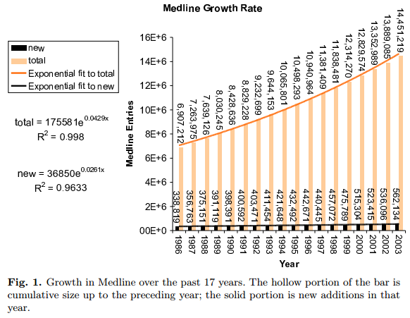

Slide 5
Challenges
NLP is as difficult as it is important
NLP requires enormous amounts of knowledge, on a number of levels.
“morphology”, and “syntax”
E.g. “These findings suggest that FAK functions in the regulation of cell migration and cell proliferation”
FAK plays a role in cell proliferation and in the regulation of cell migration
FAK plays a role in the regulation of cell proliferation and in the regulation of cell migration?

Slide 6
NLP and Systems Biology
Automated techniques for handling the literature attractive by fueling a rate of publication
Progress in the field of NLP possible by providing a huge body of data in a restricted domain for training and evaluation of NLP systems
Applications:
automated literature searches on sets of genes returned by an experiment
annotation of gene lists with Gene Ontology concepts
improvement of homolog search
management of literature search results
aids to database curation
database population

Slide 7
Where NLP fits in the analysis pipeline
At the beginning, by aiding in the analysis of the output of high-throughput assays, thus helping the scientist bring a project from experiment to publication.
At the end, by helping the working researcher exploit the flood of publications that fills Medline at the rate of 1500 abstracts a day.

Slide 8
Database population and curation
Idea: if protein names could be located in text, then we could automatically populate databases of facts about proteins - their interactions with other proteins.
bibliometric techniques: based on assumption that if two proteins are mentioned in the same text (suffer from problems related to entity identification).
information extraction techniques: offers a more constrained approach, targets a very restricted set of types of assertions.

Slide 9
Aids to analysis of high-throughput assays
Early system (MedMiner): automatic literature searches on large numbers of genes found to be of significance in an expression array study
lead to thousands of articles being returned by a literature search
helps the experimenters navigate these large bodies of literature of interest to molecular biologists

Slide 10
Interaction and pathways
Concentrated on networks of interactions and on pathway discovery - interactions between proteins:
Proteins and drugs
Proteins and diseases
Proteins and subcellular locations
Same linguistic and computational problems

Slide 11
Issues and resources in natural language processing
Evaluation
Metrics: precision, recall, and F-measure on the output of a system, evaluated against a gold standard
Bake-offs: KDD Cup, TREC 2003, BioCreative
Entity identification: require the ability to recognize references to genes and gene products in text
Eg: association of ADHD with DRD4 and DRD5
DRD4 and DRD5 are genes
ADHD is not
rule-based: rely on combinations of regular expression
machine-learning-based approaches

Slide 12
Issues and resources (cont)
Information extraction (IE): is the location of assertions about restricted classes of facts in free text.
thought of as a ‘robust’ approach to NL understanding, try to build system understand assertions rather than understand all aspects
Approach: rule-based, machine-learning-based
Common keywords:
interact
associate
bind
complex
inhibit
activate
regulate
encode
function
phosphorylate

Slide 13
Things that make information extraction difficult
Entity identification is frequently cited in error analyses as a source of low recall
Leads to missed assertions
Coordination: the linking of structures by words
Negation: often simply ignored
Anaphora: references to entities that have been named earlier, often by words like it

Slide 14
Low-level linguistic analysis and preprocessing (IE)
sentence tokenization
a chunk of text into individual sentences
word-level tokenization
breaking the input into word-sized chunks
entity identification
part-of-speech tagging
Brill part-of-speech tagger, Trigrams’n’Tags part-of-speech tagger
Stemming
interact is the stem of interacts, interacted, interacting, and interaction
abbreviation expansion
BioText project (java code rule-based), Chang et al.(XML/RPC)
Public tools from The National Library of Medicine
lvg (lexical variant generation), a set of Java API’s for normalizing and generating variant forms of biomedical terms
MetaMap, a system for finding biomedical concepts in free text.

Slide 15
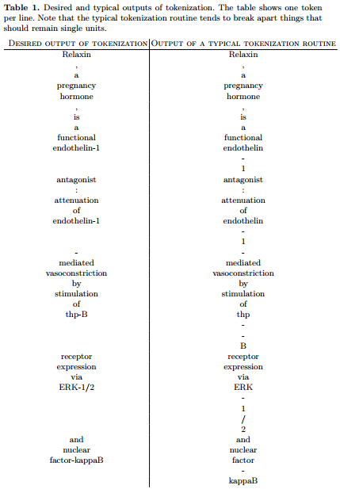

Slide 16
Information retrieval
Find subsets of documents in a larger set that are relevant to some query
Relevant research issues:
Indexing
Massive synonymy of the items of interest
Multi-word units
Difficulty of mapping to a standard ontology
Query construction
Clustering/categorization
Top-down: organizes a document set according to a pre-existing model of how a user models the conceptual domain. (AlcoGene system) topics addressed:
nervous system structures
behaviors
ion channels
protein kinases
quantitative trait loci
Bottom-up: is based on similarities between documents in a set as determined by some metric. (Vivisimo’s system) separates to a number of categories:
breast (13 documents)
activation of caspase (12 documents)
hepatocellular carcinoma (10 documents)
Visualization
navigate the contents of large document collections (ThemeRiver)

Slide 17
Further reading
General NLP:
D. Jurafsky and James H. Martin. Speech and language processing: an introduction
to natural language processing, computational linguistics and speech recognition. Prentice Hall, 2000.
General information extraction, information retrieval, text categorization, entity identification, and summarization
L. Tanabe. Text mining the biomedical literature for genetic knowledge. PhD thesis, George Mason University doctoral dissertation., 2003
Statistical approaches to general NLP
C.D. Manning and H. Sch¨utze. Foundations of statistical natural language processing. MIT Press, 1999
Information retrieval in biomedical domains
G. Salton. Automatic text processing: the transformation, analysis, and retrieval of information by computer. Addison-Wesley Publishing Company, 1989
W. Hersh. Information retrieval: a health and biomedical perspective. Springer Verlag, 2nd ed edition, 2002
Systems Biology
C. Blaschke, L. Hirschman, and A. Valencia. Information extraction in molecular biology. Briefings in Bioinformatics, 3(2):154–165, 2002
M.D. Yandell and W.H. Majoros. Genomics and natural language processing. Nature Reviews/Genetics, Vol. 3:601–610, Aug. 2002
D.B. Searls. The computational linguistics of biological sequences. In L. Hunter, editor, Artificial Intelligence and Molecular Biology, pages 47–121. MIT Press, 1993

